Slide 1

IMAGE DEDUPLICATION USING DEEP LEARNING
Submitted by
Batch No.: A09
B DINESH K.VENKATESH G.PREETHI SREE K R NANDHISH M DELLI | 19121A1206 19121A1259 19121A1238 19121A1244 19121A1227
Supervisor
MS.CH.Prathima,M.Tech,Professor

Slide 2
CONTENTS:
Abstract
Introduction
Problem Definition
Objectives
Proposed System
Expected Outcomes
Conclusion

Slide 3
ABSTRACT:
Now a days major issue in our society is duplication of all the objects in terms of images while capturing. For example, if we take a folder in our PC it allows to store same image with different names. Here wastage of memory is more. So, to avoid duplication of images, we need to scan the content inside the file and identify whether the images are duplicate or not. This process is known as CBIR (Content Based Image Retrieval). We have many techniques to find duplicate images. CNN (Convolution Neural Networks), Phash (perceptual hash), Block Truncation Technique etc. are used to find the image similarity identification and to avoid wastage of memory. Our proposed work is to capture images and store in a folder to identify the duplicate images and delete them. We developed an user interface to delete the duplicate images using folder path for user friendly usage.

Slide 4
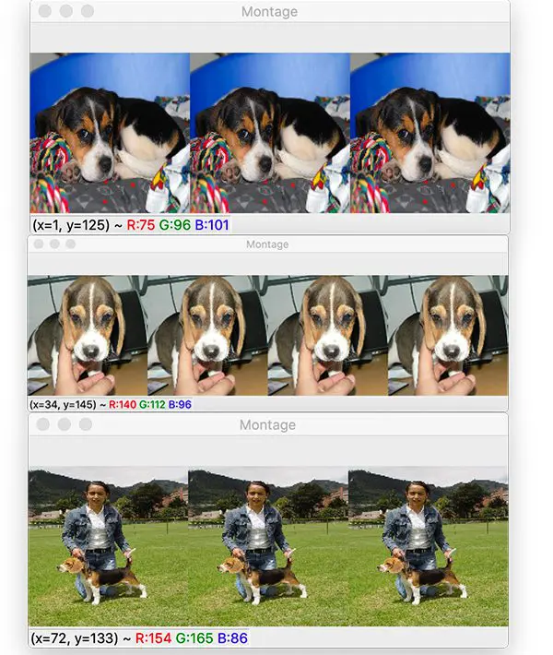
INTRODUCTION
What is the necessary of deduplication ?

Slide 5
In our day to day life we deal with huge amount of multimedia like images, videos, songs.
Same images are shared through multiple platforms like WhatsApp, Instagram, Facebook, and Telegram.
All these images are stored in our phone or pc. This causes wastage of memory.
A record or volume that is backed up every week creates a huge amount of duplicate data.
Even storing of same image with different resolutions, sizes, pixels causes duplicate data.

Slide 6
To store important data and access the data fast, we need to clear all the duplicate data.
But to clear such a huge amount of duplicate data manually, it is difficult for every one. All the users feels lazy to do manually.
So we need some automatic systems to clear all this junk and duplicate data.
To do this we are having many methods using artificial Intelligence, deep learning, and Machine learning.
Some of them are:
1)CNN
2)Phash
3)Image Hashing
4)Block Truncation techniques

Slide 7
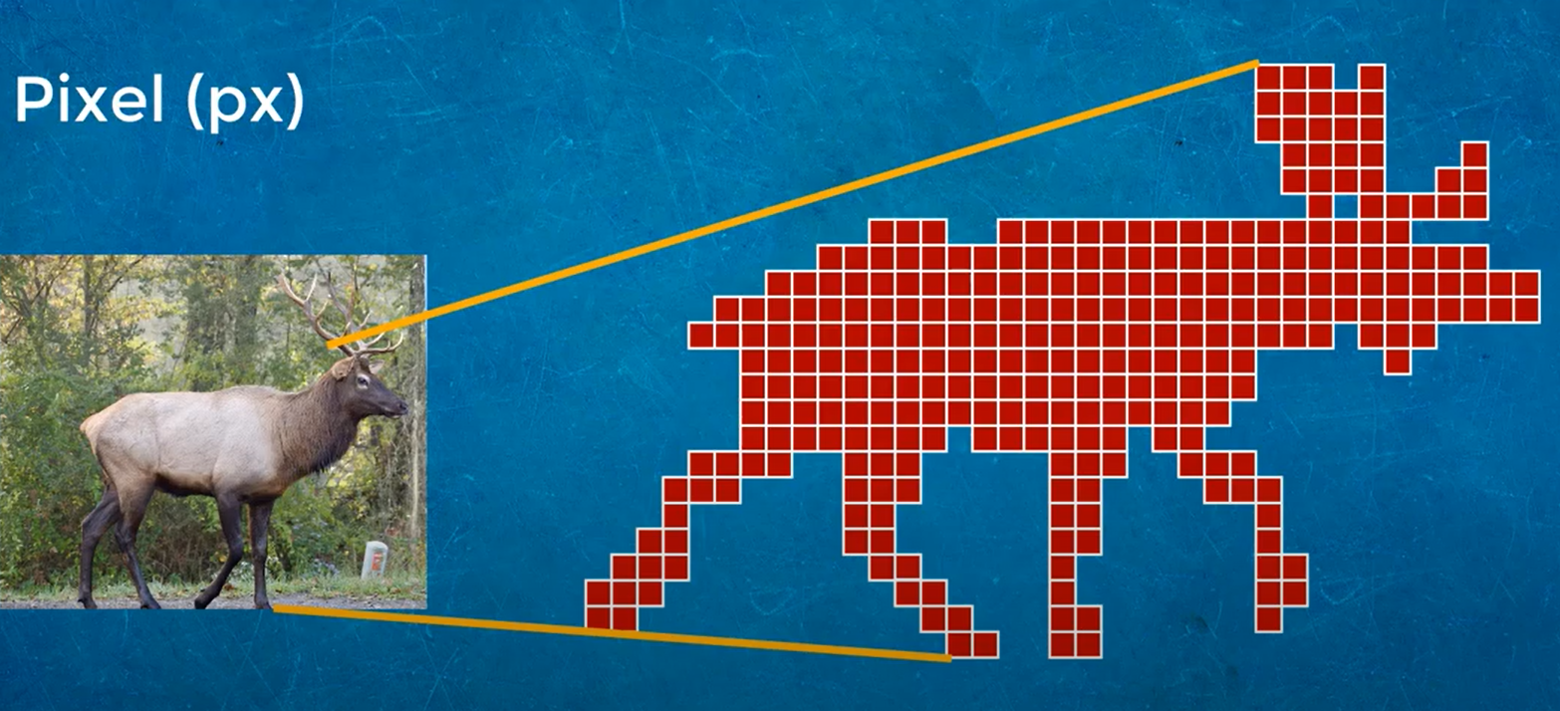
Deduplication of images lowers storage costs as fewer disks are needed. It also increases disaster recovery because there is less data to transfer. Backup and archive data usually includes a huge amount of duplicate data.
We can differentiate the images by scanning it through pixels.
Every image will have different hash functions.
This helps us to find duplicate images.

Slide 8
SURVEY
This survey was done to know the opinions of the people from different sections like a student, faculty, lab admin and public regarding issues raised by duplicate images.
Student: - We surveyed a student who was facing major issues with the same images but with different file names in his phone gallery. Whenever this student reaches his Instagram or any social media, various images are been generated over those platforms. In turn those repeated or the same images are been stored in the gallery of student which reduces the storage space in the device also makes to work slowly

Slide 9
Faculty: - A faculty was also been surveyed regarding the issues of duplicate images. In general faculty would be circulating various images regarding syllabus, circulars, exam schedules also need to deal with the images with respect to the profession. Also being busy in the profession it is highly impossible to delete the duplicate images stored in the gallery. Probably the space recovered by deleted duplicate images could be utilized for useful purpose.

Slide 10
Lab admin: - The work done by an administrator especially in labs faces major problems of duplicated images in their systems.
Even this might lead to lose a much greater storage spaces in their databases or even in the individual systems. Because many of the students who are working over systems are going in a same flow. That is majority of them are following the instructions of their mentors and technicians. Here the same images would be seen at last in a huge number which couldn’t be deleted manually.

Slide 11
Neighbours: - Even the common public near and around us are also facing major issues with the duplicate images. Particularly images generated in the WhatsApp groups, social media, in general usage, many of the duplicate images are saved in the galleries. Which reduces the storage capacity and also makes them to work slowly. Moreover the reduction of duplicate images is necessary as it is impossible to search the similar images in the storage space. Also the fast running lifestyle got used for better technologies to do their work efficiently.

Slide 12
PROBLEM DEFINITION
The major issue is duplicate or redundant data and storage problems. This is every one’s issue who uses phones and computers. Even in big data centers, 25 percent of duplicate data is stored. If we talk about images, the same images are stored with different names in same folder or directory. Now the problem is to clear this duplicate images. We feel lazy to clear this manually. Even we can clear duplicate data if the data size is in small range. It is difficult to delete duplicates from huge data sets. Here manual work is late and complex to complete. In this running world, no body will spend more time to do this. To overcome this problem, we need an automatic process.

Slide 13
Proposed work:
To overcome above problem we came up with an user interface which interacts with user and asks a folder path containing duplicate images. If the user gives the path and click on submit button, then all the duplicate images are deleted.
This helps user to delete the images fast and efficient manner.
The interface is user friendly and fast access.
The background code is implemented using python.

Slide 14
OBJECTIVES:
Main objectives are:
To detect and remove the redundant images.
Eliminating redundant data will help to shrink storage requirements and improve bandwidth efficiency.
An user interface is developed for user friendly usage.
User can paste the folder path containing duplicate images in the entry field and clear the duplicates.
This saves user time as it is fast and efficient method.
.

Slide 15
IMPLEMENTATION

Slide 16
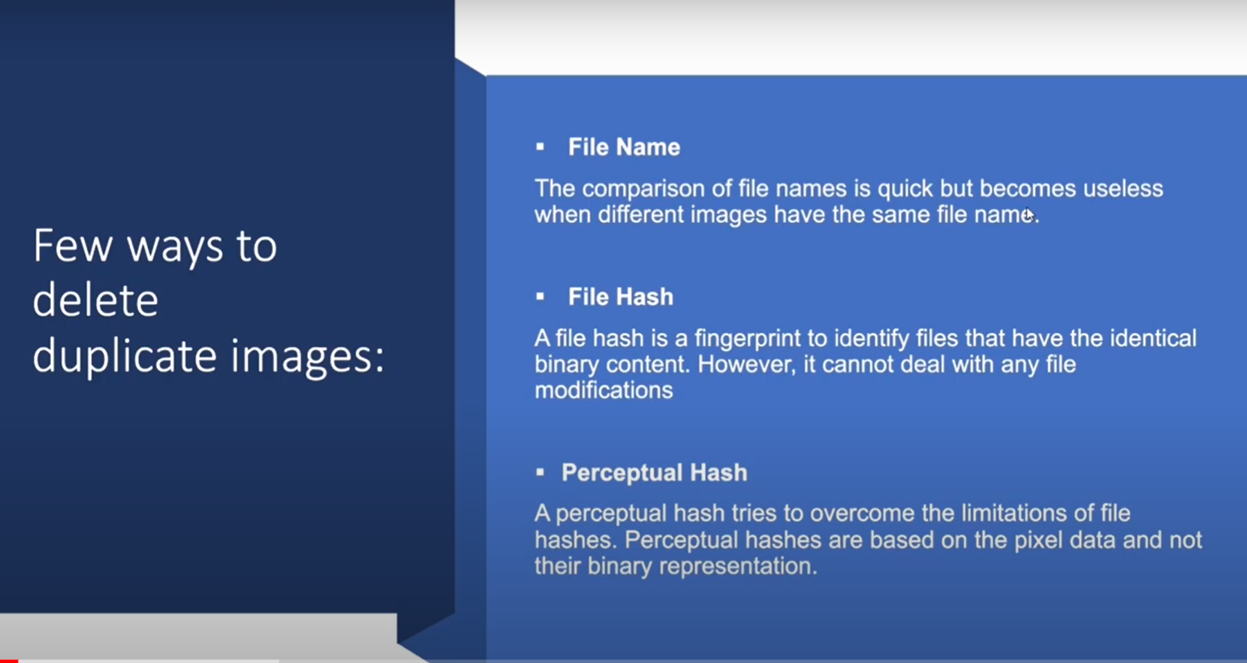

Slide 17
IMPLEMENTATION OF USER INTERFACE USING TKINTER:
The tkinter package or library (“Tk interface”) is the Python interface to the Tk GUI toolkit. Both Tk and tkinter are available on most Unix platforms, as well as on Windows systems.
Running python -m tkinter from the command prompt will open a window demonstrating a simple Tk interface, letting you know that tkinter is properly installed on your system, and also showing what version of Tcl/Tk is installed, so you can read the Tcl/Tk documentation specific to that version.
Tk is a Tcl package implemented in C that adds custom commands to create and manipulate GUI widgets. Each Tk object embeds its own Tcl interpreter instance with Tk loaded into it. Tk’s widgets are very customizable, though at the cost of a dated appearance. Tk uses Tcl’s event queue to generate and process GUI events.

Slide 18
Tinker Modules
Support for Tkinter is spread across several modules. Most applications will need the main tkinter module, as well as the tkinter.ttk module, which provides the modern themed widget set and API:
from tkinter import *
from tkinter import ttk
Tcl/Tk 8.5 (2007) introduced a modern set of themed user interface components along with a new API to use them. Both old and new APIs are still available. Most documentation you will find online still uses the old API and can be woefully outdated.

Slide 19
User Interface

Slide 20
Detection and deletion of duplicates:
Modules used:
From PIL import Image
import imagehash
import os
About PIL module:
Python Imaging Library is a free and open-source additional library for the Python programming language that adds support for opening, manipulating, and saving many different image file formats.
Python Imaging Library (expansion of PIL) is the de facto image processing package for Python language. It incorporates lightweight image processing tools that aids in editing, creating and saving images. Support for Python Imaging Library got discontinued in 2011, but a project named pillow forked the original PIL project and added Python3.x support to it. Pillow was announced as a replacement for PIL for future usage. Pillow supports a large number of image file formats including BMP, PNG, JPEG, and TIFF.

Slide 21
EXPECTED OUTCOMES:
Removes duplicate images
Reduce storage space
Redundancy of data is avoided
User friendly interface
Faster deletion of duplicates.

Slide 22
RESULTS

Slide 23
CONCLUSION:
By using deep learning algorithms duplicate images are detected and removed.

Slide 24
REFERENCES
S. Bhattacharjee and M. Kutter, "Compression tolerant image authentication", Proc. ICIP-'98, vol. 1, pp. 435-439, 1998-Sep.
Venkatesan and M. H. Jakubowski, "Image hashing", DIMACS Conf. on Intellectual Property Protection, 2000-Apr.
.R. Venkatesan and S.-M. Koon, Robust image hashing into binary strings, manuscript, 1999.
R. Venkatesan, S. M. Koon, M. H. Jakubowski and P. Moulin, "Robust image hashing", Proc. IEEE Conf. Image Processing, pp. 664-666, 2000-Sep.

Slide 25
C.-S. Lu and H.-Y. M. Liao, "Structural digital signature for image authentication", IEEE Trans. Multimedia, vol. 5, no. 3, pp. 161-173, Jun. 2003.
S. S. Kozat, K. Mihcak and R. Venkatesan, "Robust perceptual image hashing via matrix invariances", Proc. IEEE Conf. Image Processing, pp. 3443-3446, 2004-Oct.
V. Monga, A. Banerjee and B. L. Evans, "Clustering algorithms for perceptual image hashing", Proc. IEEE Digital Signal Processing Workshop., pp. 283-287, 2004-Aug.

Slide 26

THANK YOU

